Slide 1
Overview of Data Mining Concepts and Data Types
P. Krishna Reddy
IIIT Hyderabad

Slide 2
Reference
Chapter 1 and Chapter 2 of the text book.

Slide 3
Detailed Syllabus
Introduction (1.5 hour): Definition, KDD framework, Issues in data mining.
Data summarization (7.5 hrs): Data Types, Preprocessing, Characterization, Discrimination, data warehousing techniques (Multidimensional data model, Data warehousing architecture, Data cube computation and OLAP technology)
Concepts and algorithms for mining patterns and associations (9 hours) (Frequent item-set generation, A priori and FP-growth algorithm, Evaluation of Association patterns) and preprocessing
Concepts and algorithms related to classification and regression (9hrs) (Overview, Decision tree induction, Over-fitting and under-fitting, Scalable decision tree algorithms, Bayesian Classification, Regression-based Prediction methods (9 hours)
Concepts and algorithms for clustering the data (9 hours) (Overview, Types of Data, K-means, Aglomerative clustering, Clustering algorithms (DBSCAN, BIRCH, CURE, ROCK, CHAMELEON)).
Outlier analysis and future trends (graph mining, spatio-temporal mining). (3 hours)

Slide 4
Presentation Outline
Data mining functionalities
Research Issues in Data mining
Sources of data
Data Objects and Attribute Types
Basic Statistical Descriptions of Data
Data Visualization
Case study
Summary

Slide 5
Data Mining Functionalities
Generalization/Summarization: characterization and discrimination
Pattern mining, Association mining, correlation
Classification
Clustering
Outlier analysis
Sequential, trend and evolution analysis
Structure and network analysis

Slide 6
Data Mining Function: (1) Generalization
Information integration and data warehouse construction
Data cleaning, transformation, integration, and multidimensional data model
Data cube technology
Scalable methods for computing (i.e., materializing) multidimensional aggregates
OLAP (online analytical processing)
Multidimensional concept description: Characterization and discrimination
Generalize, summarize, and contrast data characteristics, e.g., dry vs. wet region
Notes:
I BELIEVE WE MAY NEED TO DO IT IN MORE IN-DEPTH INTRODUCTION, USING SOME EXAMPLES. So it will take one slide for one function, i.e., one chapter we want to cover. Do we need to cover chapter 2: preprocessing and 3. Statistical methods?

Slide 7
Concept description: Characterization and discrimination
Generalize, summarize, and contrast data characteristics, e.g., dry vs. wet regions.
Example
Initial Relation
Prime Generalized Relation

Slide 8
Tabulation of Data
Tabulation facilitates the presentation of large information into concise way under different titles and sub-titles.
Table 1. Students
Class | Rural |  |  |  | Urban
 | Male |  | Female |  | Male |  | Female
 | Hostellers | Day Scholars | Hostellers | Day scholars | Hostellers | Day Scholars | Hostellers | Day scholars
Intermediate
Graduate
Post Graduate

Slide 9
Data Mining Function: (2) Association and Correlation Analysis
Frequent patterns (or frequent itemsets)
What items are frequently purchased together in your Walmart?
Association, correlation vs. causality
A typical association rule
Diaper → Beer [0.5%, 75%] (support, confidence)
Are strongly associated items also strongly correlated?
How to mine such patterns and rules efficiently in large datasets?
How to use such patterns for classification, clustering, and other applications?

Slide 10
Approaches to mine Association Rules
Apriori approach
FP Tree approach
Hash-based itemset counting: A k-itemset whose corresponding hashing bucket count is below the threshold cannot be frequent
Transaction reduction: A transaction that does not contain any frequent k-itemset is useless in subsequent scans
Partitioning: Any itemset that is potentially frequent in DB must be frequent in at least one of the partitions of DB
Sampling: mining on a subset of given data, lower support threshold + a method to determine the completeness
Dynamic itemset counting: add new candidate itemsets only when all of their subsets are estimated to be frequent

Slide 11
Data Mining Function: (3) Classification
Classification and label prediction
Construct models (functions) based on some training examples
Describe and distinguish classes or concepts for future prediction
E.g., classify countries based on (climate), or classify cars based on (gas mileage)
Predict some unknown class labels
Typical applications:
Credit card fraud detection, direct marketing, classifying stars, diseases, web-pages, …

Slide 12
Approaches to classification
Decision tree
Bayesian Classification
Neural networks
Association based classification
k-nearest neighbor classifier
Case-based reasoning
Genetic algorithm
Rough set approach
Fuzzy set approaches

Slide 13
Data Mining Function: (4) Cluster Analysis
Unsupervised learning (i.e., Class label is unknown)
Group data to form new categories (i.e., clusters), e.g., cluster houses to find distribution patterns
Principle: Maximizing intra-class similarity & minimizing interclass similarity
Many methods and applications

Slide 14
Major Clustering Approaches
Partitioning algorithms: Construct various partitions and then evaluate them by some criterion
Hierarchy algorithms: Create a hierarchical decomposition of the set of data (or objects) using some criterion
Density-based: based on connectivity and density functions
Grid-based: based on a multiple-level granularity structure
Model-based: A model is hypothesized for each of the clusters and the idea is to find the best fit of that model to each other

Slide 15
Data Mining Function: (5) Outlier Analysis
Outlier analysis
Outlier: A data object that does not comply with the general behavior of the data
Noise or exception? ― One person’s garbage could be another person’s treasure
Methods: by product of clustering or regression analysis, …
Useful in fraud detection, rare events analysis

Slide 16
Time and Ordering: Sequential Pattern, Trend and Evolution Analysis
Sequence, trend and evolution analysis
Trend, time-series, and deviation analysis: e.g., regression and value prediction
Sequential pattern mining
e.g., first buy digital camera, then buy large SD memory cards
Periodicity analysis
Motifs and biological sequence analysis
Approximate and consecutive motifs
Similarity-based analysis
Mining data streams
Ordered, time-varying, potentially infinite, data streams

Slide 17
Structure and Network Analysis
Graph mining
Finding frequent subgraphs (e.g., chemical compounds), trees (XML), substructures (web fragments)
Information network analysis
Social networks: actors (objects, nodes) and relationships (edges)
e.g., author networks in CS, terrorist networks
Multiple heterogeneous networks
A person could be multiple information networks: friends, family, classmates, …
Links carry a lot of semantic information: Link mining
Web mining
Web is a big information network: from PageRank to Google
Analysis of Web information networks
Web community discovery, opinion mining, usage mining, …
Notes:
This chapter will not be in the new version, will it?
BUT SHOULD WESTILL INTRODCE THEM SO THAT THEY WILL GET AN OVERALL PICTURE?

Slide 18
Data Mining: Confluence of Multiple Disciplines
Machine
Learning
Pattern
Recognition
Statistics
Applications
Data Mining
Visualization
Algorithm
Database
Technology
High-Performance
Computing

Slide 19
Presentation Outline
Data mining functionalities
Research Issues in Data mining
Sources of data
Data Objects and Attribute Types
Basic Statistical Descriptions of Data
Data Visualization
Case study
Summary

Slide 20
Evaluation of Knowledge
Are all mined knowledge interesting?
One can mine tremendous amount of “patterns” and knowledge
Some may fit only certain dimension space (time, location, …)
Some may not be representative, may be transient, …
Evaluation of mined knowledge → directly mine only interesting knowledge?
Descriptive vs. predictive
Coverage
Typicality vs. novelty
Accuracy
Timeliness
…

Slide 21
Applications of Data Mining
Web page analysis: from web page classification, clustering to PageRank & HITS algorithms
Collaborative analysis & recommender systems
Basket data analysis to targeted marketing
Biological and medical data analysis: classification, cluster analysis (microarray data analysis), biological sequence analysis, biological network analysis
Data mining and software engineering (e.g., IEEE Computer, Aug. 2009 issue)
From major dedicated data mining systems/tools (e.g., SAS, MS SQL-Server Analysis Manager, Oracle Data Mining Tools) to invisible data mining

Slide 22
Why Confluence of Multiple Disciplines?
Tremendous amount of data
Algorithms must be highly scalable to handle such as tera-bytes of data
High-dimensionality of data
Micro-array may have tens of thousands of dimensions
High complexity of data
Data streams and sensor data
Time-series data, temporal data, sequence data
Structure data, graphs, social networks and multi-linked data
Heterogeneous databases and legacy databases
Spatial, spatiotemporal, multimedia, text and Web data
Software programs, scientific simulations
New and sophisticated applications
Notes:
Add a definition/description of “traditional data analysis”.

Slide 23
Major Issues in Data Mining (1)
Mining Methodology
Mining various and new kinds of knowledge
Mining knowledge in multi-dimensional space
Data mining: An interdisciplinary effort
Boosting the power of discovery in a networked environment
Handling noise, uncertainty, and incompleteness of data
Pattern evaluation and pattern- or constraint-guided mining
User Interaction
Interactive mining
Incorporation of background knowledge
Presentation and visualization of data mining results

Slide 24
Major Issues in Data Mining (2)
Efficiency and Scalability
Efficiency and scalability of data mining algorithms
Parallel, distributed, stream, and incremental mining methods
Diversity of data types
Handling complex types of data
Mining dynamic, networked, and global data repositories
Data mining and society
Social impacts of data mining
Privacy-preserving data mining
Invisible data mining

Slide 25
Research Issues in Data Mining
Data mining (knowledge discovery in databases):
Extraction of interesting (non-trivial, implicit, previously unknown and potentially useful) information or patterns from data in large databases
So far data mining means
Summarization, Association rules, clustering, classification
Research Issues
Finding new patterns
Market basket data, Complex data, stream data
Improving the performance of existing algorithms
Scalable algorithms
Data, features or dimensions
Complex data
Visualizing the patterns

Slide 26
Multi-Dimensional View of Data Mining
Data to be mined
Database data (extended-relational, object-oriented, heterogeneous, legacy), data warehouse, transactional data, stream, spatiotemporal, time-series, sequence, text and web, multi-media, graphs & social and information networks
Knowledge to be mined (or: Data mining functions)
Characterization, discrimination, association, classification, clustering, trend/deviation, outlier analysis, etc.
Descriptive vs. predictive data mining
Multiple/integrated functions and mining at multiple levels
Techniques utilized
Data-intensive, data warehouse (OLAP), machine learning, statistics, pattern recognition, visualization, high-performance, etc.
Applications adapted
Retail, telecommunication, banking, fraud analysis, bio-data mining, stock market analysis, text mining, Web mining, etc.

Slide 27
Presentation Outline
Data mining functionalities
Research Issues in Data mining
Sources of data
Data Objects and Attribute Types
Basic Statistical Descriptions of Data
Data Visualization
Summary

Slide 28
Data Mining: On What Kinds of Data?
Database-oriented data sets and applications
Relational database, data warehouse, transactional database
Advanced data sets and advanced applications
Data streams and sensor data
Time-series data, temporal data, sequence data (incl. bio-sequences)
Structure data, graphs, social networks and multi-linked data
Object-relational databases
Heterogeneous databases and legacy databases
Spatial data and spatiotemporal data
Multimedia database
Text databases
The World-Wide Web

Slide 29
Sources of data
Primary data
Primary data or raw data is a type of information that is obtained directly from the first-hand source through experiments, surveys or observations.
Examples of primary data
Autobiographies and memoirs.
Diaries, personal letters, and correspondence.
Interviews, surveys, and fieldwork.
Internet communications on email, blogs, listservs, and newsgroups.
Photographs, drawings, and posters.
Works of art and literature.
Secondary data
Secondary data means data collected by someone else earlier.
Examples of secondary data
Tax records and social security data.
Census data.
Electoral statistics.
Health records.
Books, journals, or other print media.
Social media monitoring, internet searches, and other online data.
Sales figures or other reports from third-party companies.

Slide 30
Example of primary data collection
Quantitative methods
Quantitative research is the process of collecting and analyzing numerical data. It can be used to find patterns and averages, make predictions, test causal relationships, and generalize results to wider populations.
Qualitative methods
Examples
One-on-one interviews.
Interviews are one of the most common qualitative data-collection methods, and they're a great approach when you need to gather highly personalized information
Open-ended surveys and questionnaires.
Focused groups
Observation
Case studies

Slide 31
A few sample questions
Next few slides contain a few sample survey questions

Slide 32
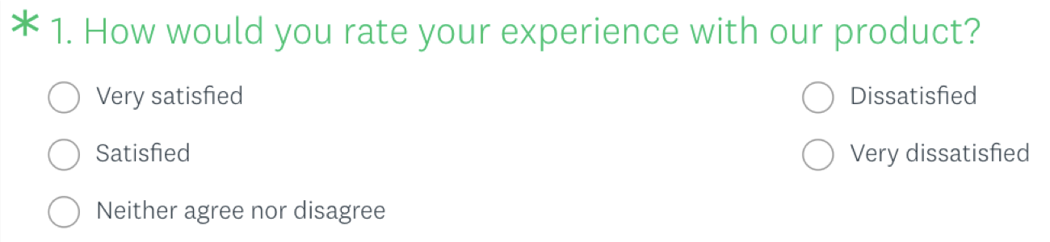
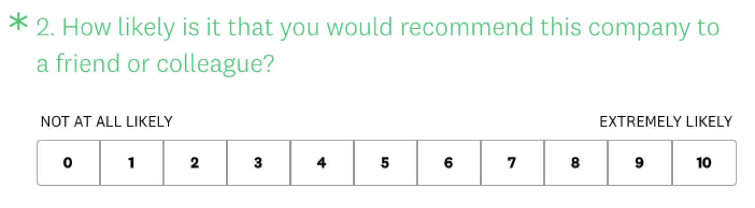
Single-answer multiple choice question.
Rating scales questions
Source: https://www.surveymonkey.com/mp/survey-question-types/

Slide 33

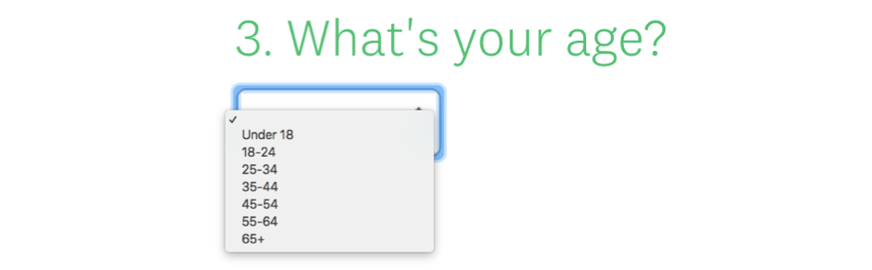
Likert scales: Do you agree or disagree
Dropdown questions

Slide 34
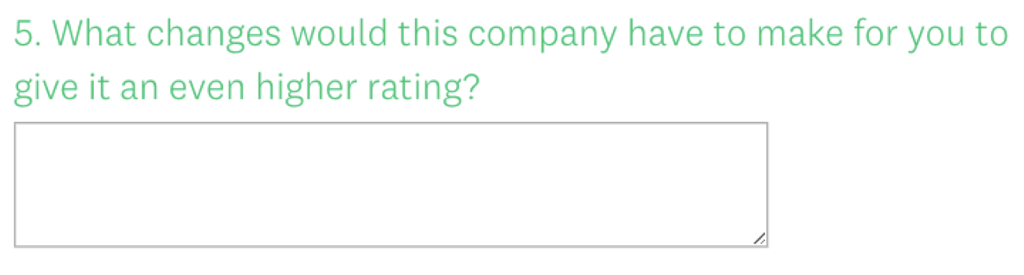
Open-ended questions
Open-ended survey questions require respondents to type their answer into a comment box and don’t provide specific pre-set answer options. Responses are then viewed individually or by text analysis tools.

Slide 35
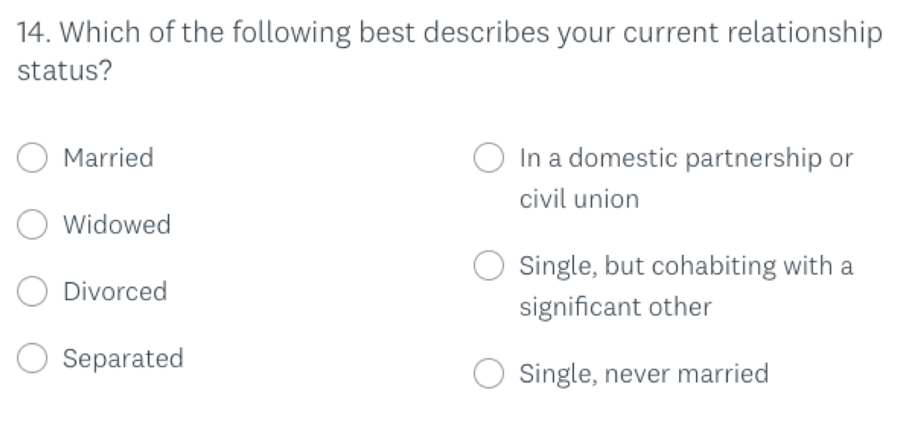
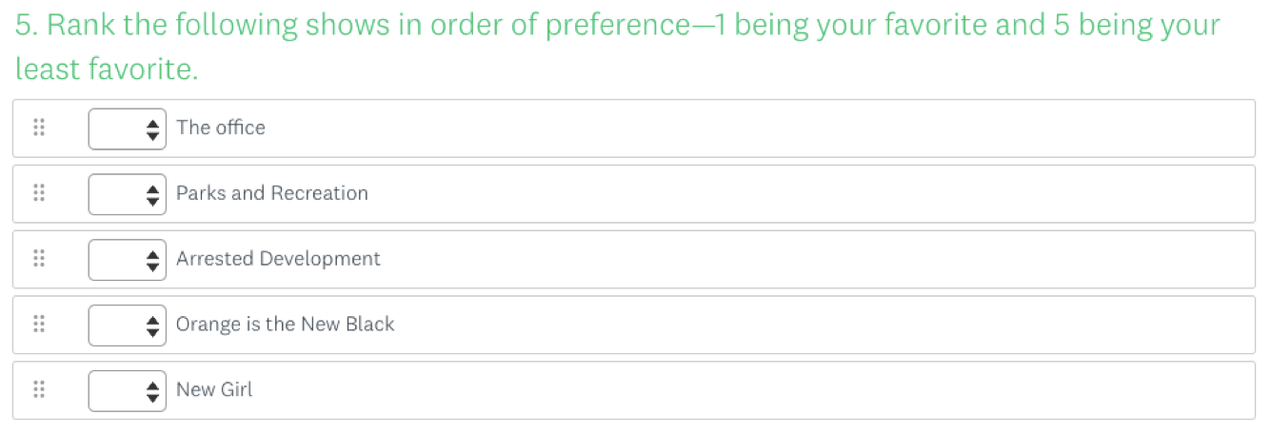
Demographic questions
Ranking questions

Slide 36
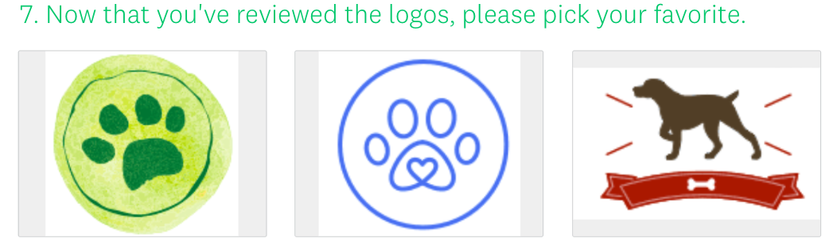

Image choice questions
Click map questions

Slide 37

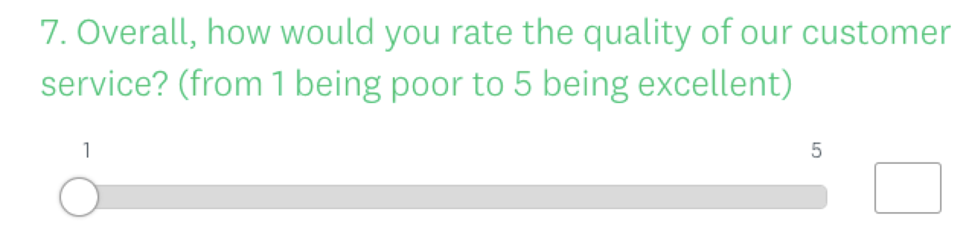
File upload questions: Uploading of resume or image
Slider questions

Slide 38
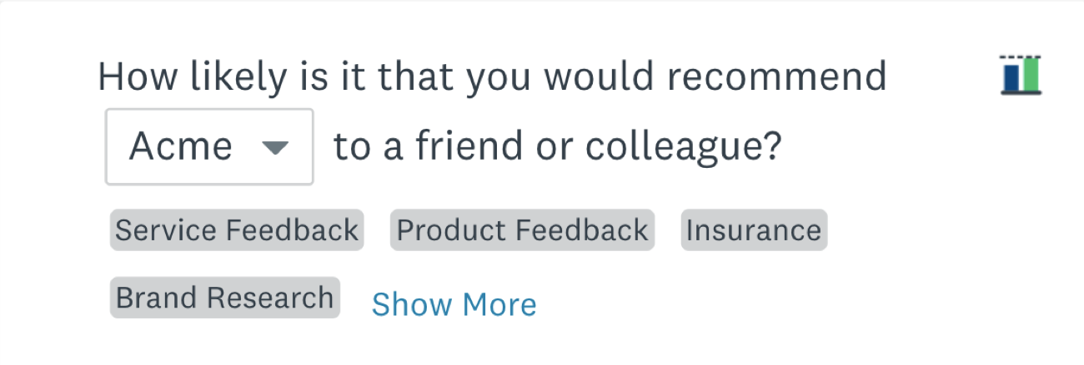
Benchmarkable questions

Slide 39
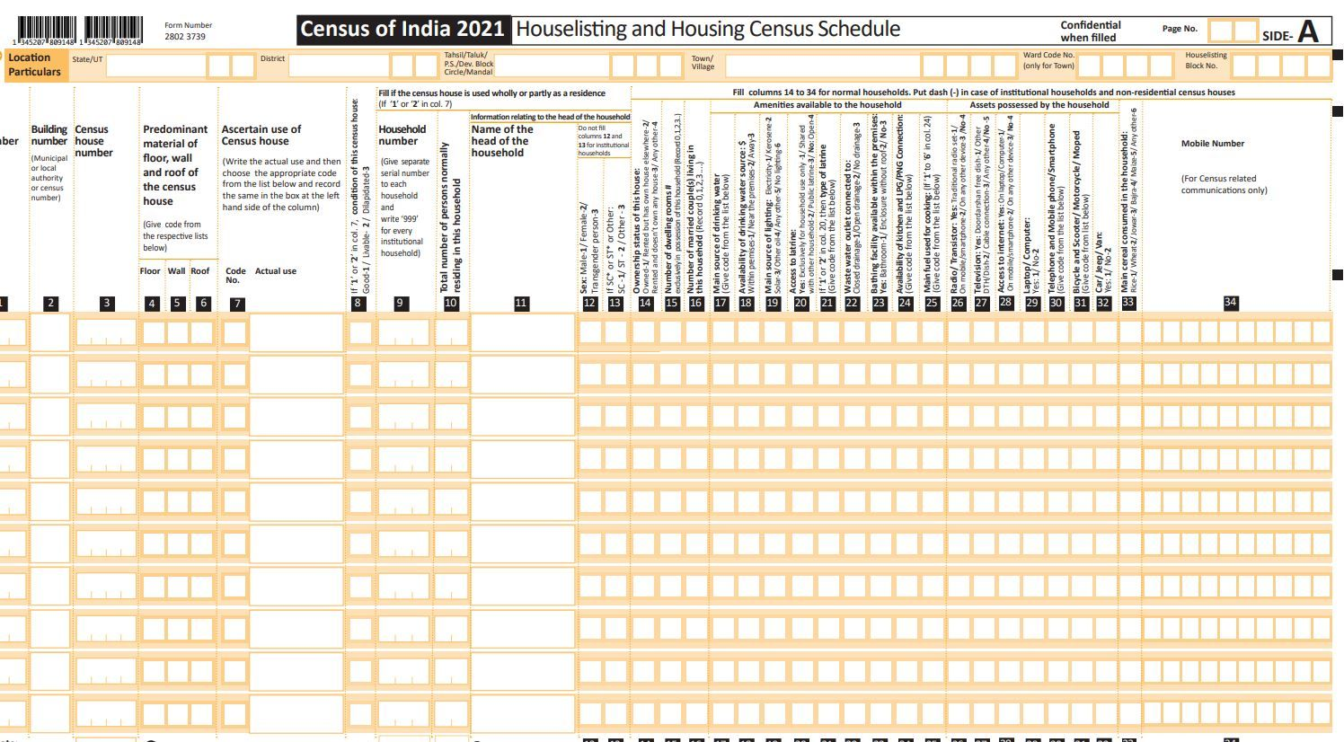

Slide 40
Presentation Outline
Data mining functionalities
Research Issues in Data mining
Sources of data
Data Objects and Attribute Types
Basic Statistical Descriptions of Data
Data Visualization
Case study
Summary

Slide 41
Data Objects
Data sets are made up of data objects.
A data object represents an entity.
Examples:
sales database: customers, store items, sales
medical database: patients, treatments
university database: students, professors, courses
Also called samples , examples, instances, data points, objects, tuples, records, vector, patten, event, case, observation or entity
Data objects are described by attributes.
Database rows -> data objects; columns ->attributes.

Slide 42
Types of Data Sets
Record
Relational records
Data matrix, e.g., numerical matrix, crosstabs
Document data: text documents: term-frequency vector
Transaction data
Graph and network
World Wide Web
Social or information networks
Molecular Structures
Ordered
Video data: sequence of images
Temporal data: time-series
Sequential Data: transaction sequences
Genetic sequence data
Spatial, image and multimedia:
Spatial data: maps
Image data:
Video data:

Slide 43
Attributes
Attribute (or dimensions, features, variables):
a data field, representing a characteristic or feature of a data object.
E.g., customer _ID, name, address
A measurement scale:
Associates a numerical or symbolic value with an attribute of an object.
Type of attribute: Type of measurement of scale
Attribute Types:
Qualitative/categorical attributes
Nominal attributes
Binary attributes
Ordinal attributes
Quantitative attributes or numeric attributes
Interval-scaled attributes
Ratio-scaled attributes
Variables
Qualitative
Quantitative
Discrete
Continuous
Ordered
Unordered

Slide 44
Qualitative Attributes
Nominal attributes : categories, states, or “names of things”
Hair_color = {auburn, black, blond, brown, grey, red, white}
marital status, occupation, ID numbers, zip codes
No order
Mean/median can not be calculated. Mode is the option.
One-to-one mapping
Binary attributes: Nominal attribute with only 2 states (0 and 1)
Symmetric binary attribute: both outcomes equally important
e.g., gender
Asymmetric binary attribute: outcomes not equally important.
e.g., medical test (positive vs. negative)
Convention: assign 1 to most important outcome (e.g., HIV positive)
Ordinal
Values have a meaningful order (ranking) but magnitude between successive values is not known.
Example
Size = {small, medium, large}, grades, army rankings
Customer satisfaction: 0: very satisfied, 1: some dissatisfied, 2: neutral, 3: satisfied, and 4: very satisfied
Central tendency: Mode or median is the measure
New value=f(old value)

Slide 45
Quantitative Numeric Attribute Types
Quantity (integer or real-valued)
Interval
Measured on a scale of equal-sized units
Values have order
E.g., temperature in C˚or F˚, calendar dates
No true zero-point. New value= a*old value+b
Ratio
Inherent zero-point
We can speak of values as being an order of magnitude larger than the unit of measurement (10 K˚ is twice as high as 5 K˚).
e.g., temperature in Kelvin, length, counts, monetary quantities
New value= a*old-value

Slide 46
Discrete vs. Continuous Attributes
Discrete Attribute
Has only a finite or countably infinite set of values
E.g., zip codes, profession, or the set of words in a collection of documents
Sometimes, represented as integer variables
Note: Binary attributes are a special case of discrete attributes
Continuous Attribute
Has real numbers as attribute values
E.g., temperature, height, or weight
Practically, real values can only be measured and represented using a finite number of digits
Continuous attributes are typically represented as floating-point variables

Slide 47
Important Characteristics of Structured Data
Dimensionality
Curse of dimensionality
Sparsity
Only presence counts
Bag-of-words
Resolution
Patterns depend on the scale
Distribution
Centrality and dispersion

Slide 48
Presentation Outline
Data mining functionalities
Research Issues in Data mining
Sources of data
Data Objects and Attribute Types
Basic Statistical Descriptions of Data
Data Visualization
Summary

Slide 49
Basic Statistical Descriptions of Data
Motivation
To better understand the data: central tendency, variation and spread
Data dispersion characteristics
median, max, min, quantiles, outliers, variance, etc.
Numerical dimensions correspond to sorted intervals
Data dispersion: analyzed with multiple granularities of precision
Boxplot or quantile analysis on sorted intervals
Dispersion analysis on computed measures
Folding measures into numerical dimensions
Boxplot or quantile analysis on the transformed cube

Slide 50
Basic Statistical Descriptions of Data
Measures of Central Tendency (middle or center of the distribution)
Mean, Median, Mode, Geometric Mean, Harmonic Mean
Variability measures or measuring the dispersion. How the data is spread out?
Range, Quartile Deviation, Mean Deviation, Standard Deviation, Coefficient of Variation
Skewness
Constructing a boxplot

Slide 51
Measures of Central Tendency
A group of data is represented with a single number
It brings very important information from it

Slide 52
Arithmetic Mean
Arithmetic mean: Sum of observations divided by its number.
Note: n is sample size and N is population size.
Weighted arithmetic mean:
Trimmed mean: chopping extreme values
It should be computable.
Mean from categorical data is not calculable
Advantages: Can carry out algebraic manipulations.
Demerits:
Gives more weight to extreme items (outliers).

Slide 53
Median
Median: Middle value if odd number of values, or average of the middle two values otherwise
Merits
It can be calculated even if extreme classes are not defined.
Property
Sum of absolute deviations from is least when it is taken from median.
Demerits
Not based on all observations
Not widely used in practice

Slide 54
Mode
Mode: It is the value which occurs most frequently.
Merits
It can be easily located
It can be calculated when extreme classes are not defined
It is used widely in the business.
It can be calculated easily except if maximum frequency occurs more than once.
Demerits
Not based on the all observations
It is not having algebraic properties.
It is not stable
Different class intervals results into different mode value.
The relationship between mean, median and mode
Mean - mode=3(mean-median)

Slide 55
Selecting among the mean, median and mode
Common mistake: specifying the wrong index of central tendency
It is common to specify the mean
If data is categorical, if yes use “mode”.
If no
If the total is of interest, use “mean”
If no
If the distribution is skewed, use “median”
Otherwise, use “mean”
Type of micro processor → use mode
Total CPU time → mean
Skew: ratio of minimum and maximum is large, the data is skewed.

Slide 56
Summarizing the Variability
It is a measure which can give the wide spread or scattering of observations among themselves or from a center point.
Range, Quartile deviation, Mean deviation, and standard deviation (variance)
Range:
The difference between the highest and lowest values in a series of observations.
Problem: it depends on two extreme values.
Quartile deviation
Quartile deviation (Q.D)=(Q₃-Q₁)/2, where Q1 is first quartile, Q3 is third quartile. The first and third quartiles are called lower and upper quartiles, respectively.
First quartile: The value of the variate below which one fourth of the values lie and above which three fourth of the values lie, when the values are arranged in ascending order of the magnitude.
Third quartile: The value of the variate below which three fourth of the values lie and above which the remaining one fourth of the values lie, when the values are arranged in ascending order of the magnitude.
Merits:
The presence of abnormal values do not affect quartile deviation.

Slide 57
Mean deviation, Standard Deviation, Variance
Mean Deviation: The mean deviation is the mean of the absolute values of the deviations taken from the average.
Standard deviation: It is defined as the square root of the mean of the squares of the deviations taken from arithmetic mean.
σ =square root( 1/n ∑ (x1- X)²⁾ where X is arithmetic mean
Variance: Square of standard deviation.

Slide 58
Coefficient of Variation
CV is the percentage ratio of S.D to mean.
CV= (SD/Mean)*100
For a player scores: if CV is high he/she is inconsistent,

Slide 59
Statistical Population
Population: All the values/objects
Sample: A part of population.
A sample should be a representative of population
Should be taken in a random manner.
Population is specified with parameters
Sample is specified with statistics
Population error: Difference between the sample mean and population mean.

Slide 60
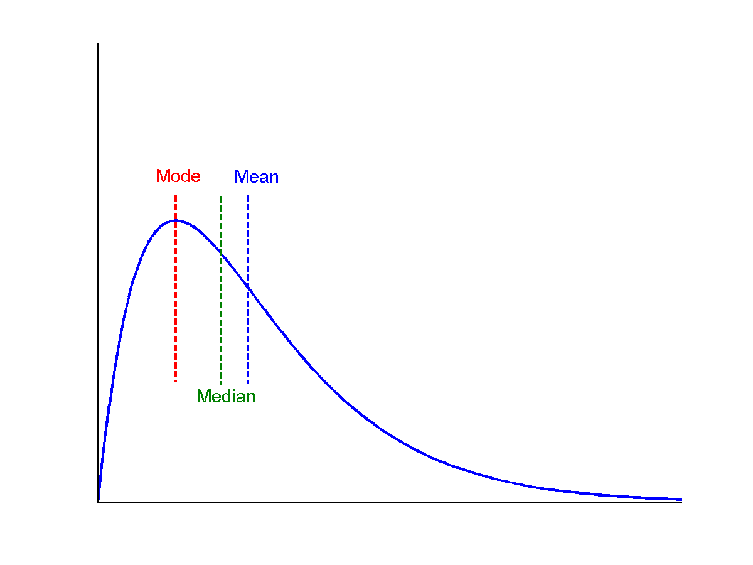
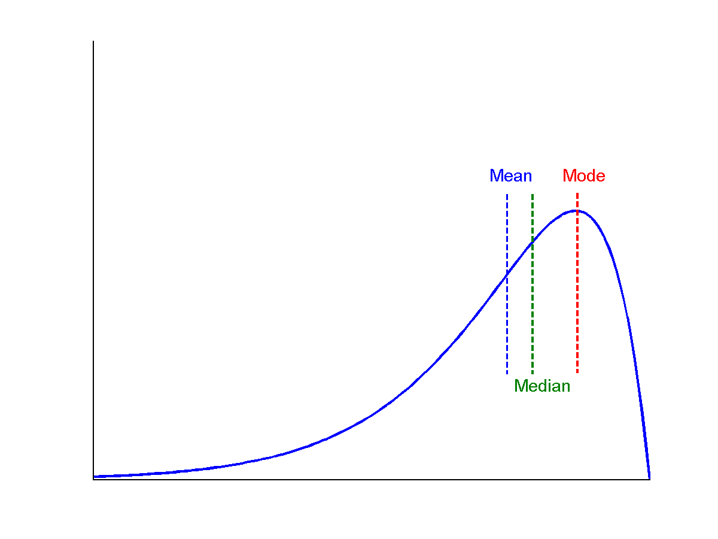
Symmetric vs. Skewed Data
Even if two measures mean and standard deviations are same for the distributions, still the shape of two curves may differ.
symmetric
positively skewed
negatively skewed

Slide 61
Determining the Distribution of Data
Simplest way is to plot the histogram of data
Requires dividing the range into a number of sub-ranges called cells or buckets.
The count of observations that fall into each cell are determined.
The counts are normalized to frequencies by dividing by the total number of observations. The cell frequencies are plotted as a column chart
Key problem in determining the cell size.
Small cells leads to very few observations per cell and a large variations in the number of observations.
Large cells results into less variations, but the details of observations is completely lost.
Guideline: if a cell has fewer than five observations, the cell size should be increased or variable cell histogram should be used.

Slide 62
Measures of Skewness
Pearson’s Coefficient of skewness
(Mean-mode)/SD
Quartile coefficient of skewness
((Q3-Q2)-(Q2-Q1))/(Q3-Q1)

Slide 63
Selecting Index of Dispersion
If the variable is bounded, use “range”.
If there are no natural bounds, and the distribution is symmetric use either SD, variance or CV.
If the distribution is non-symmetric, percentiles are best choices.

Slide 64
Box Plot or The 5 Number Summary
A box plot or boxplot (also known as a box-and-whisker diagram or plot) is a convenient way of graphically depicting groups of numerical data through their five-number summaries:
the smallest observation (sample minimum),
lower quartile (Q1),
median (Q2),
upper quartile (Q3), and
largest observation (sample maximum).
A boxplot may also indicate which observations, if any, might be considered outliers.
usually, a value higher/lower than 1.5 x IQR

Slide 65
Constructing a box and whisker plot
Step 1 - Find the median.
Remember, the median is the middle value in a data set.
18, 27, 34, 52, 54, 59, 61, 68, 78, 82, 85, 87, 91, 93, 100
68 is the median of this data set.

Slide 66
Constructing a box and whisker plot
Step 2 – Find the lower quartile.
The lower quartile is the median of the data set to the left of 68.
(18, 27, 34, 52, 54, 59, 61,) 68, 78, 82, 85, 87, 91, 93, 100
52 is the lower quartile

Slide 67
Constructing a box and whisker plot
Step 3 – Find the upper quartile.
The upper quartile is the median of the data set to the right of 68.
18, 27, 34, 52, 54, 59, 61, 68, (78, 82, 85, 87, 91, 93, 100)
87 is the upper quartile

Slide 68
Constructing a box and whisker plot
Step 4 – Find the maximum and minimum values in the set.
The maximum is the greatest value in the data set.
The minimum is the least value in the data set.
18, 27, 34, 52, 54, 59, 61, 68, 78, 82, 85, 87, 91, 93, 100
18 is the minimum and 100 is the maximum.

Slide 69
Constructing a box and whisker plot
Step 5 – Find the inter-quartile range (IQR).
The inter-quartile (IQR) range is the difference between the upper and lower quartiles.
Upper Quartile = 87
Lower Quartile = 52
87 – 52 = 35
35 = IQR

Slide 70
The 5 Number Summary
Organize the 5 number summary
Median – 68
Lower Quartile – 52
Upper Quartile – 87
Max – 100
Min – 18

Slide 71
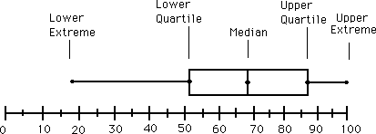
Graphing The Data
Notice, the Box includes the lower quartile, median, and upper quartile.
The Whiskers extend from the Box to the max and min.

Slide 72
Analyzing The Graph
The data values found inside the box represent the middle half ( 50%) of the data.
The line segment inside the box represents the median

Slide 73
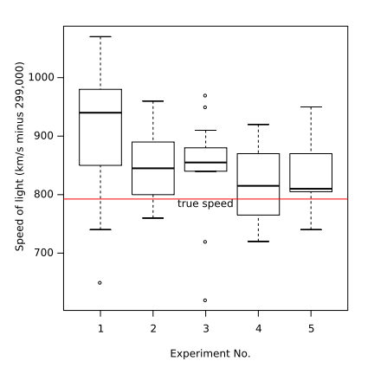
Example Box Plot

Slide 74
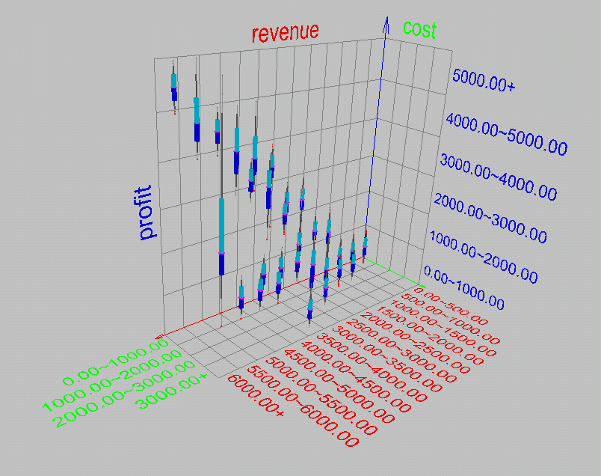
Visualization of Data Dispersion: 3-D Boxplots

Slide 75
Graphic Displays of Basic Statistical Descriptions
Boxplot: graphic display of five-number summary
Histogram: x-axis are values, y-axis repres. frequencies
Quantile plot: each value x_{i} is paired with f_{i} indicating that approximately 100 f_{i} % of data are ≤ x_{i}
Quantile-quantile (q-q) plot: graphs the quantiles of one univariant distribution against the corresponding quantiles of another
Scatter plot: each pair of values is a pair of coordinates and plotted as points in the plane

Slide 76
Histogram Analysis
Histogram: Graph display of tabulated frequencies, shown as bars
It shows what proportion of cases fall into each of several categories
Differs from a bar chart in that it is the area of the bar that denotes the value, not the height as in bar charts, a crucial distinction when the categories are not of uniform width
The categories are usually specified as non-overlapping intervals of some variable. The categories (bars) must be adjacent

Slide 77
Histograms Often Tell More than Boxplots
The two histograms shown in the left may have the same boxplot representation
The same values for: min, Q1, median, Q3, max
But they have rather different data distributions

Slide 78
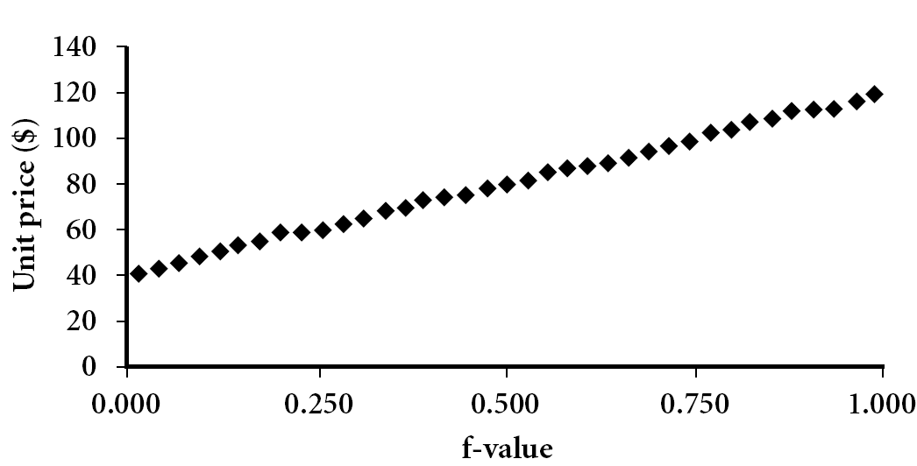
Quantile Plot
Displays all of the data (allowing the user to assess both the overall behavior and unusual occurrences)
Plots quantile information
For a data x_{i} data sorted in increasing order, f_{i} indicates that approximately 100 f_{i}% of the data are below or equal to the value x_{i}

Slide 79
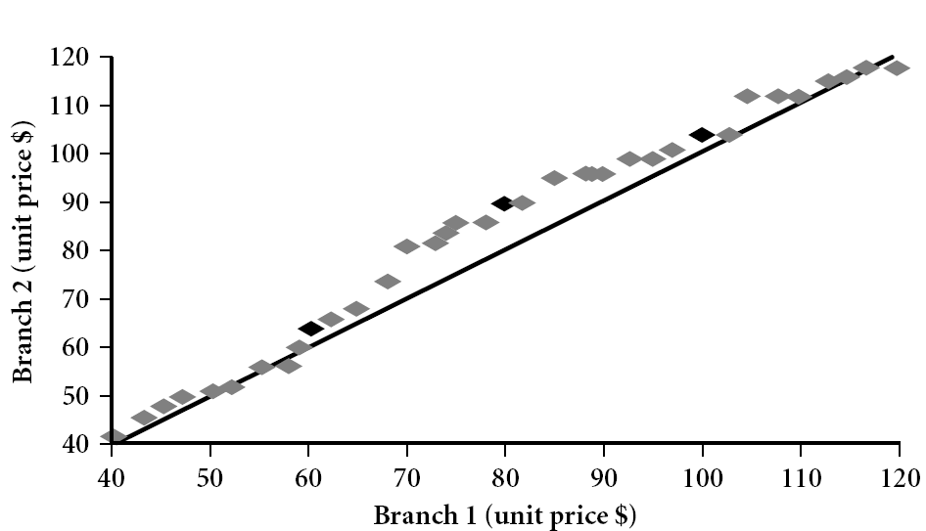
Quantile-Quantile (Q-Q) Plot
Graphs the quantiles of one univariate distribution against the corresponding quantiles of another
View: Is there is a shift in going from one distribution to another?
Example shows unit price of items sold at Branch 1 vs. Branch 2 for each quantile. Unit prices of items sold at Branch 1 tend to be lower than those at Branch 2.
Notes:
Note: We need to label the dark plotted points as Q1, Median, Q3 – that would help in understanding this graph.
Tell audience: There is a shift in distribution of branch 1 WRT branch 2 in that the unit prices of items sold at branch 1 tend to be lower than those at branch 2.

Slide 80
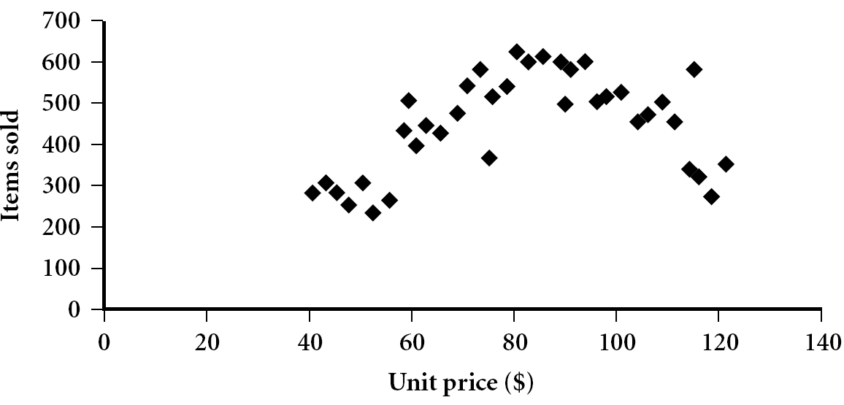
Scatter plot
Provides a first look at bivariate data to see clusters of points, outliers, etc
Each pair of values is treated as a pair of coordinates and plotted as points in the plane

Slide 81
Positively and Negatively Correlated Data
The left half fragment is positively correlated
The right half is negative correlated

Slide 82
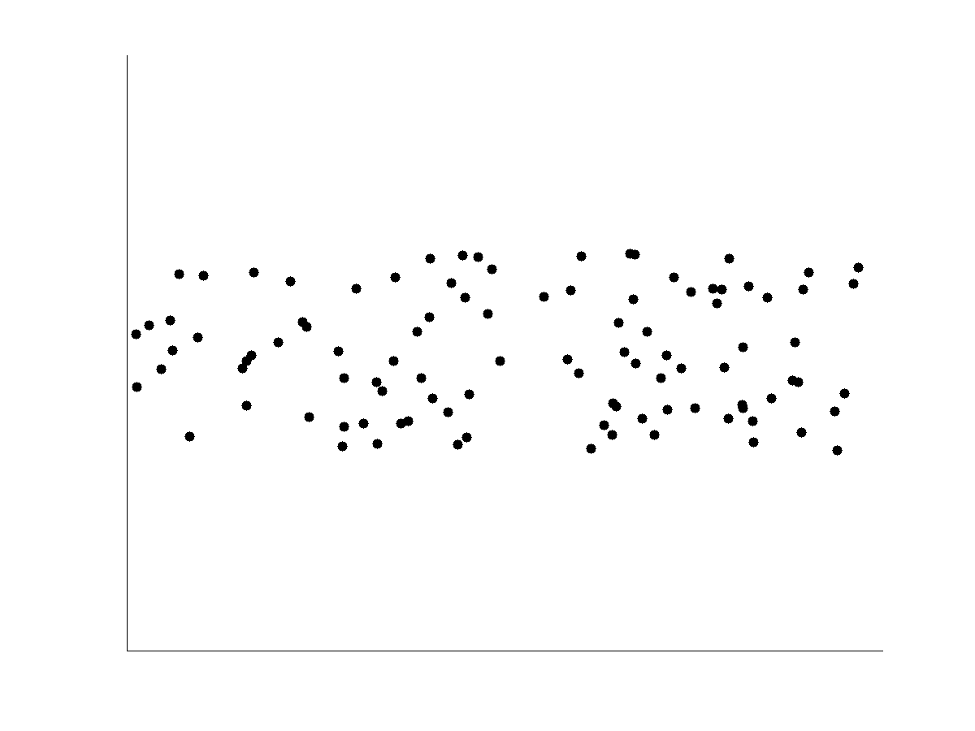
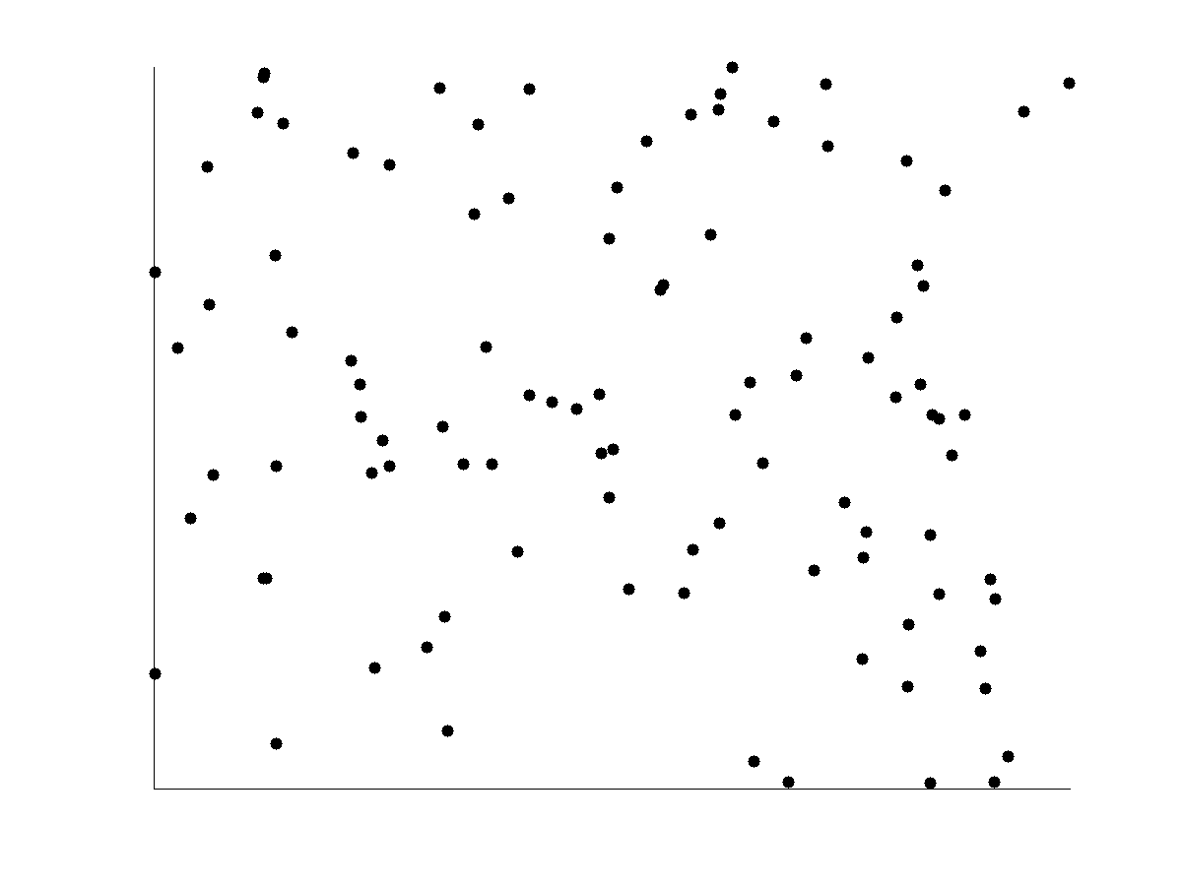
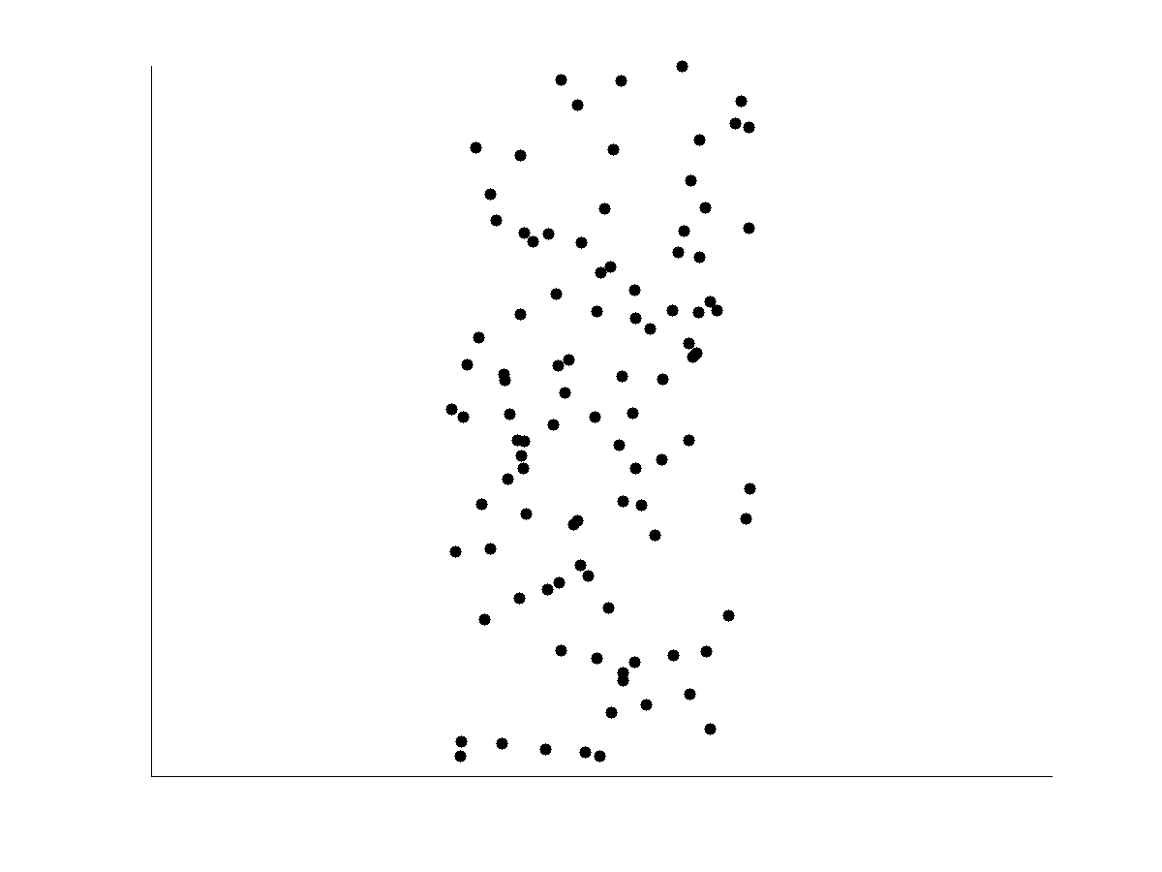
Uncorrelated Data

Slide 83
Presentation Outline
Data mining functionalities
Research Issues in Data mining
Sources of data
Data Objects and Attribute Types
Basic Statistical Descriptions of Data
Data Visualization
Case study
Summary

Slide 84
Data Visualization
Why data visualization?
Gain insight into an information space by mapping data onto graphical primitives
Provide qualitative overview of large data sets
Search for patterns, trends, structure, irregularities, relationships among data
Help find interesting regions and suitable parameters for further quantitative analysis
Provide a visual proof of computer representations derived
Categorization of visualization methods:
Pixel-oriented visualization techniques
Geometric projection visualization techniques
Icon-based visualization techniques
Hierarchical visualization techniques
Visualizing complex data and relations

Slide 85
Pixel-Oriented Visualization Techniques
For a data set of m dimensions, create m windows on the screen, one for each dimension
The m dimension values of a record are mapped to m pixels at the corresponding positions in the windows
The colors of the pixels reflect the corresponding values
Example: Income ascending order of customer information table
Income
(b) Credit Limit
(c) transaction volume
(d) age
85
Notes:
85

Slide 86
Geometric Projection Visualization Techniques
Visualization of geometric transformations and projections of the data
Methods
Scatterplot and scatterplot matrices
Landscapes
Parallel coordinates

Slide 87
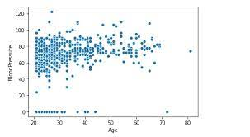
Scatter plot
A scatter plot displays 2D data points using Cartesian coordinates.

Slide 88
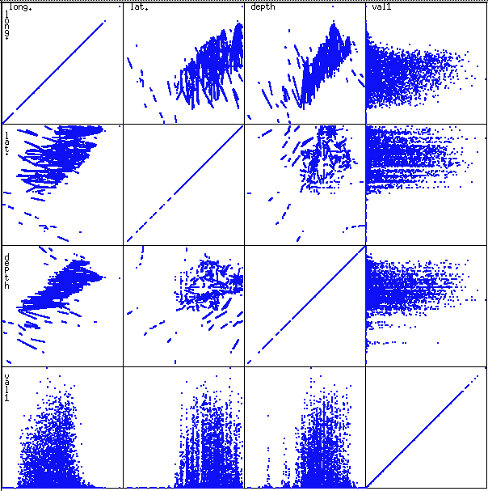
Scatterplot Matrices
Used by ermission of M. Ward, Worcester Polytechnic Institute
Matrix of scatterplots (x-y-diagrams) of the k-dim. data [total of (k2/2-k) scatterplots]

Slide 89
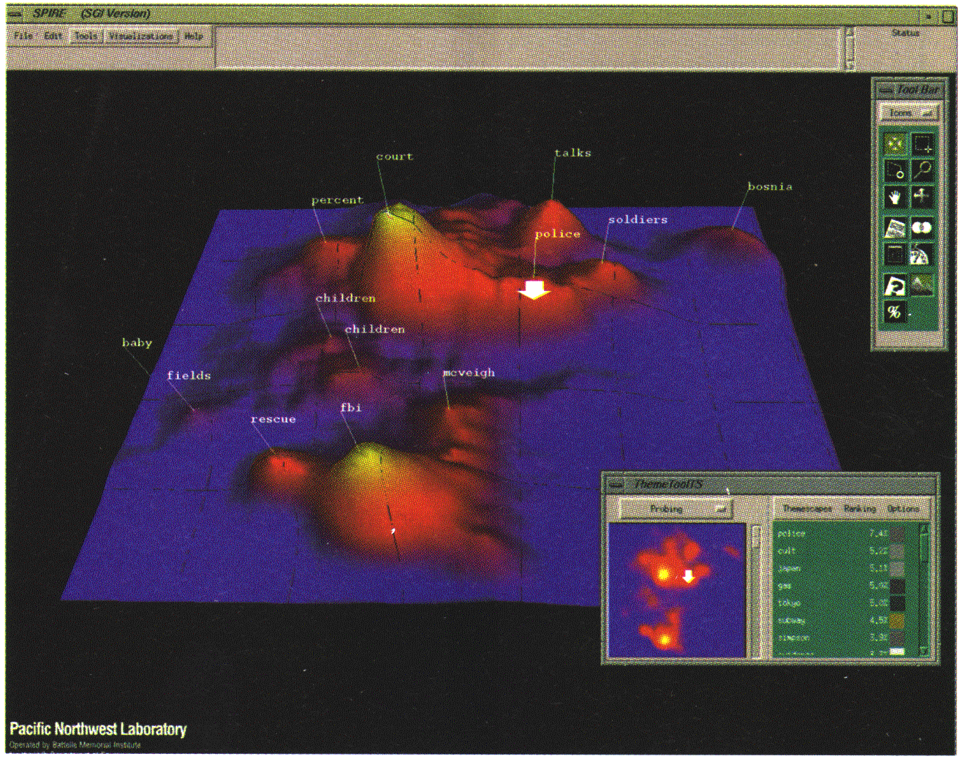
Landscapes
news articles visualized as a landscape
Used by permission of B. Wright, Visible Decisions Inc.
Visualization of the data as perspective landscape
The data needs to be transformed into a (possibly artificial) 2D spatial representation which preserves the characteristics of the data

Slide 90
Parallel Coordinates
In equidistant axes which are parallel to one of the screen axes and correspond to the attributes
The axes are scaled to the [minimum, maximum]: range of the corresponding attribute
Every data item corresponds to a polygonal line which intersects each of the axes at the point which corresponds to the value for the attribute

Slide 91
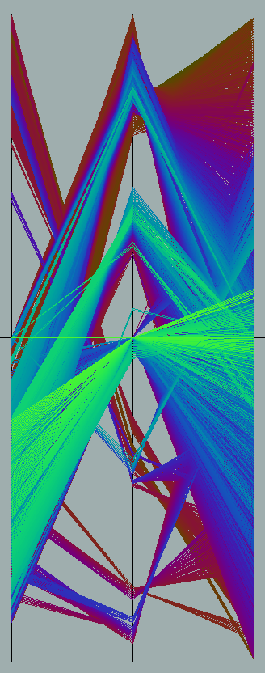
Parallel Coordinates of a Data Set

Slide 92
Icon-Based Visualization Techniques
Visualization of the data values as features of icons
Typical visualization methods
Chernoff Faces
Stick Figures
General techniques
Shape coding: Use shape to represent certain information encoding
Color icons: Use color icons to encode more information
Tile bars: Use small icons to represent the relevant feature vectors in document retrieval

Slide 93
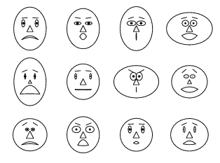
Chernoff Faces
A way to display variables on a two-dimensional surface, e.g., let x be eyebrow slant, y be eye size, z be nose length, etc.
The figure shows faces produced using 10 characteristics--head eccentricity, eye size, eye spacing, eye eccentricity, pupil size, eyebrow slant, nose size, mouth shape, mouth size, and mouth opening): Each assigned one of 10 possible values, generated using Mathematica (S. Dickson)
REFERENCE: Gonick, L. and Smith, W. The Cartoon Guide to Statistics. New York: Harper Perennial, p. 212, 1993
Weisstein, Eric W. "Chernoff Face." From MathWorld--A Wolfram Web Resource. mathworld.wolfram.com/ChernoffFace.html

Slide 94
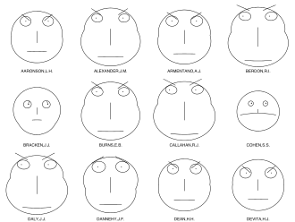
This example shows Chernoff faces for lawyers' ratings of twelve judges

Slide 95
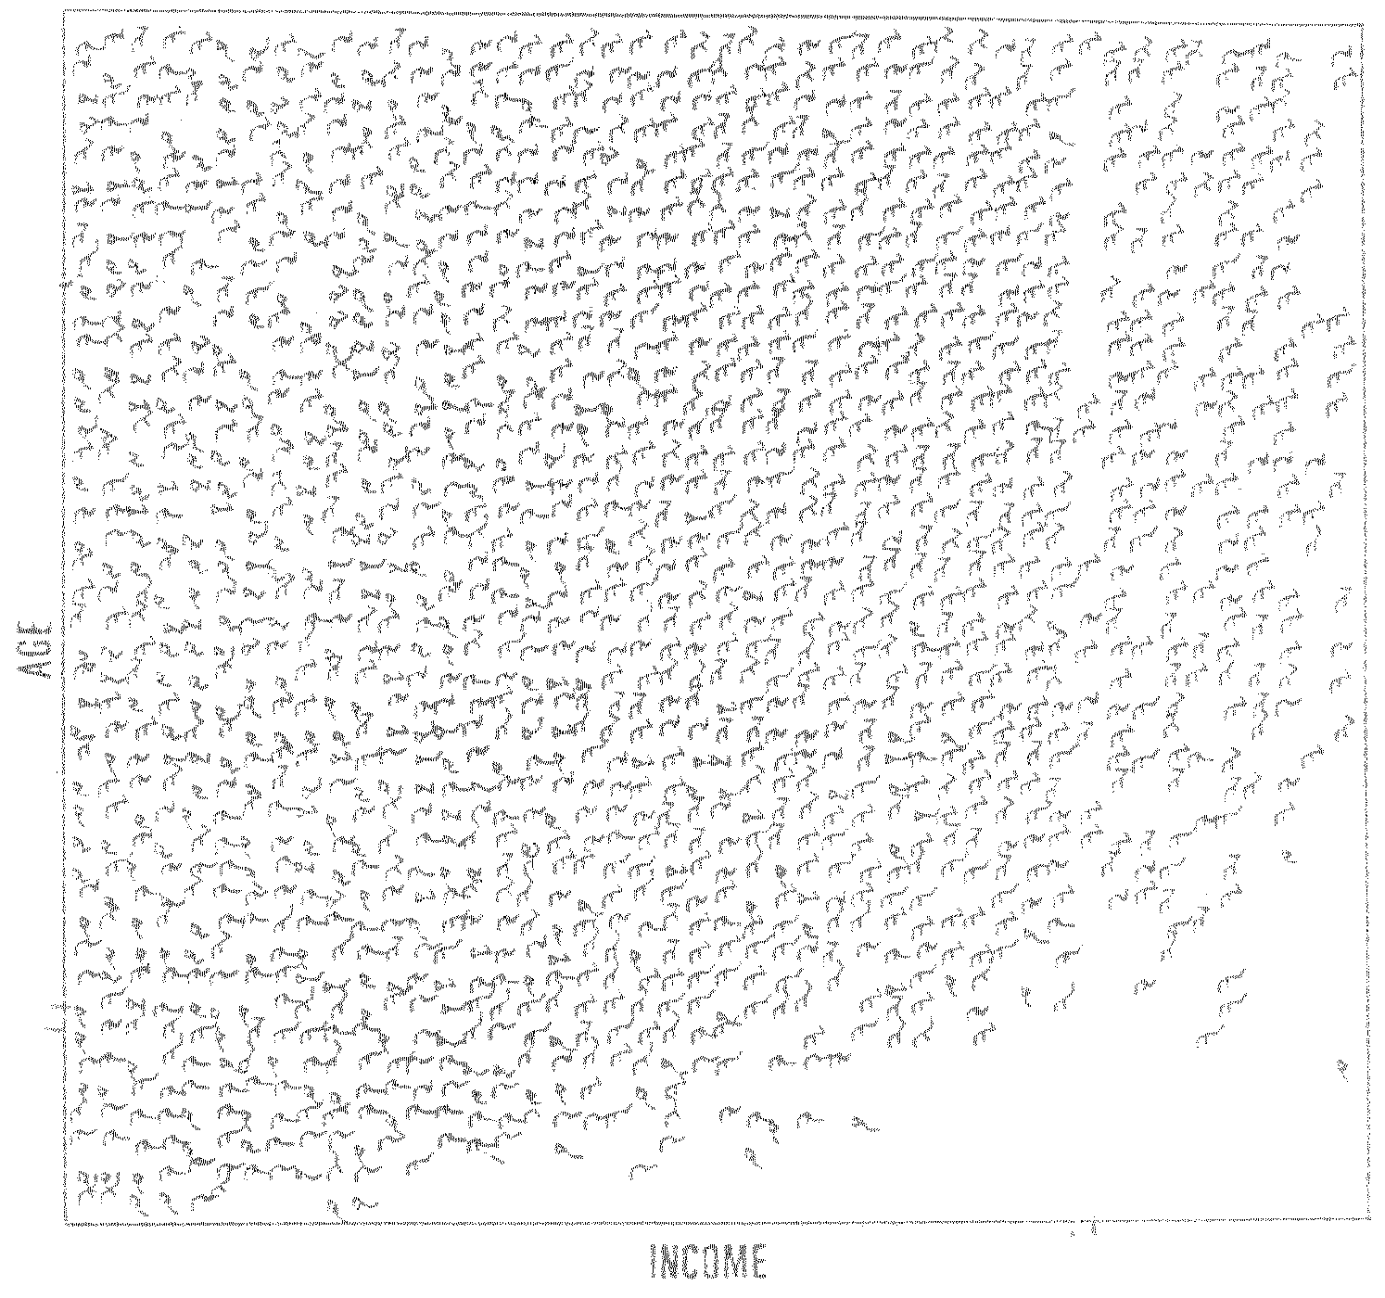
Stick Figure
A census data figure showing age, income, gender, education, etc.
used by permission of G. Grinstein, University of Massachusettes at Lowell
A 5-piece stick figure (1 body and 4 limbs w. different angle/length)
Two attributes mapped to axes, remaining attributes mapped to angle or length of limbs”. Look at texture pattern

Slide 96
Hierarchical Visualization Techniques
Visualization of the data using a hierarchical partitioning into subspaces
Dimensionality stacking
Tag cloud

Slide 97
Dimensional Stacking
Partitioning of the n-dimensional attribute space in 2-D subspaces, which are ‘stacked’ into each other
Partitioning of the attribute value ranges into classes. The important attributes should be used on the outer levels.
Adequate for data with ordinal attributes of low cardinality
But, difficult to display more than nine dimensions
Important to map dimensions appropriately

Slide 98
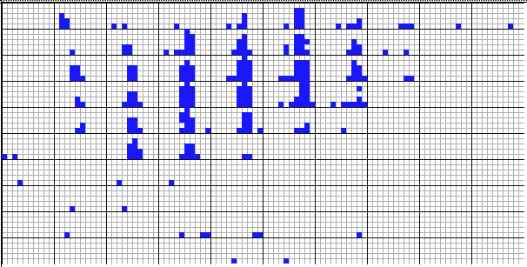
Dimensional Stacking
Used by permission of M. Ward, Worcester Polytechnic Institute
Visualization of oil mining data with longitude and latitude mapped to the outer x-, y-axes and ore grade and depth mapped to the inner x-, y-axes

Slide 99
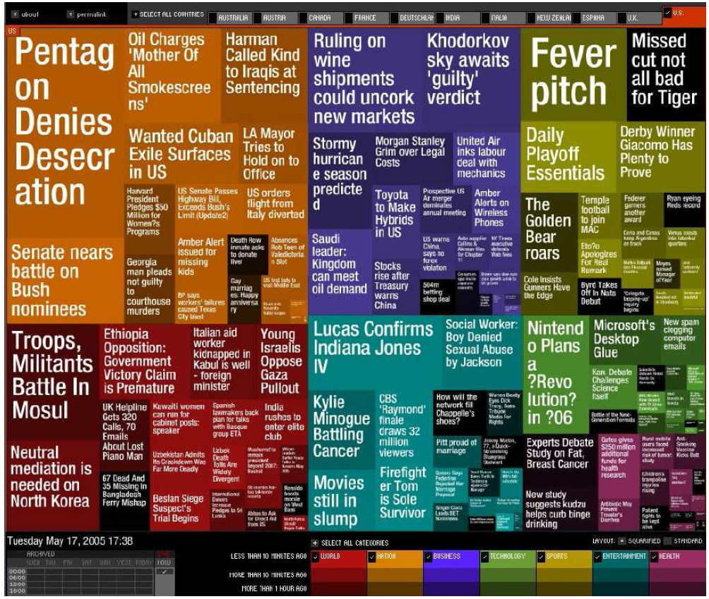
Visualizing Complex Data and Relations
Visualizing non-numerical data: text and social networks
Tag cloud: visualizing user-generated tags
The importance of tag is represented by font size/color
Besides text data, there are also methods to visualize relationships, such as visualizing social networks
Newsmap: Google News Stories in 2005

Slide 100
Presentation Outline
Data mining functionalities
Research Issues in Data mining
Sources of data
Data Objects and Attribute Types
Basic Statistical Descriptions of Data
Data Visualization
Case study
Summary

Slide 101


Case Study: Analysis of paper submissions to DASFAA-2022 conference
The 27th International Conference on Database Systems for Advanced Applications (DASFAA-2022), April 11-14, 2022, Hyderabad, India.

Slide 102
The 27th International Conference on Database Systems for Advanced Applications (DASFAA-2022), April 11-14, 2022, Hyderabad, India.
Number of valid submissions (after desk-reject): 400
Yes, this is the number; no rounding off was done!
Program committee
Reviewers: 205
Meta-Reviewers: 41
Accept
Full: 72 (18%)
Short: 76 (19%)

Slide 103
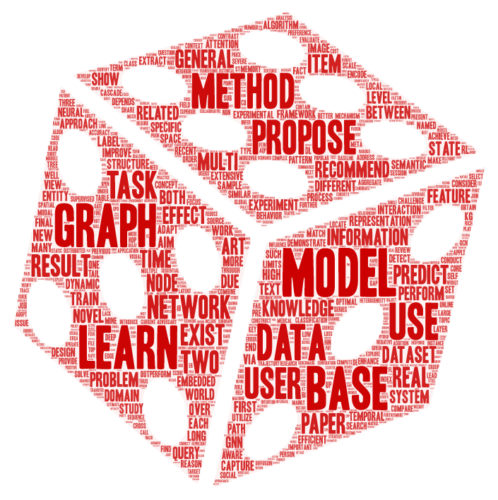
Tag Cloud from Accepted Abstracts

Slide 104
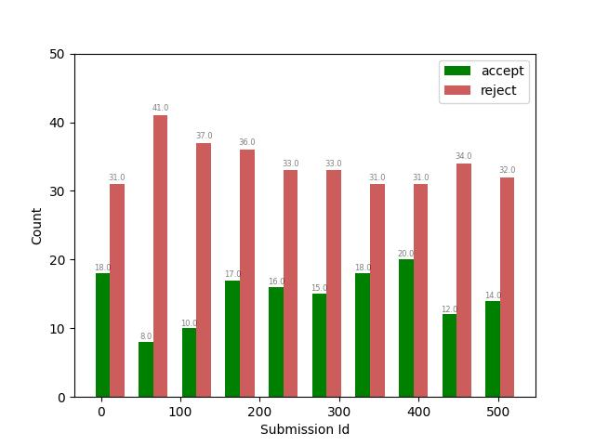
Does submission id matter?
Is there a sweet spot around 80 percentile?
How will one know when to hit the 80 percentile?

Slide 105
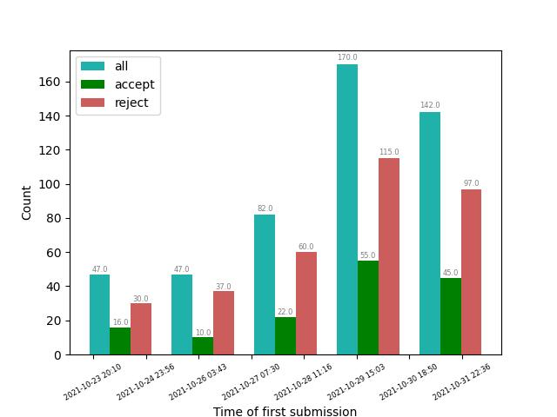
Time of first submission
1.5 to 2 days before the deadline!

Slide 106
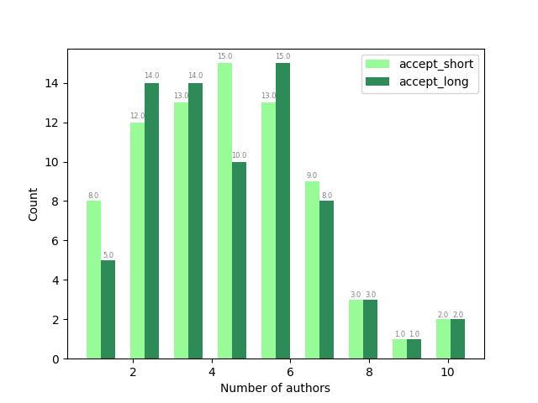
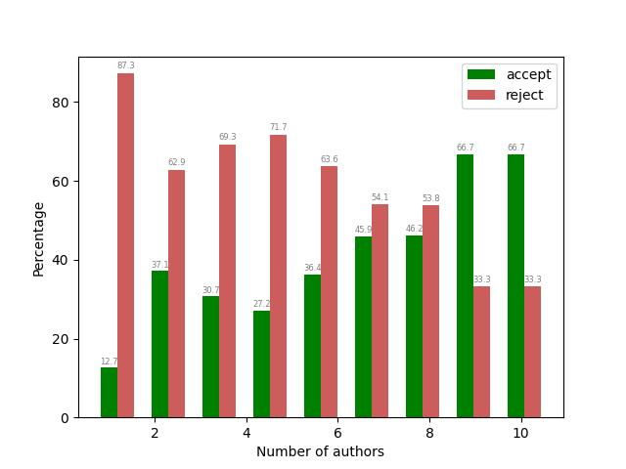
Does number of authors matter?
The more the merrier – collaborations and multiple eyes matter!

Slide 107
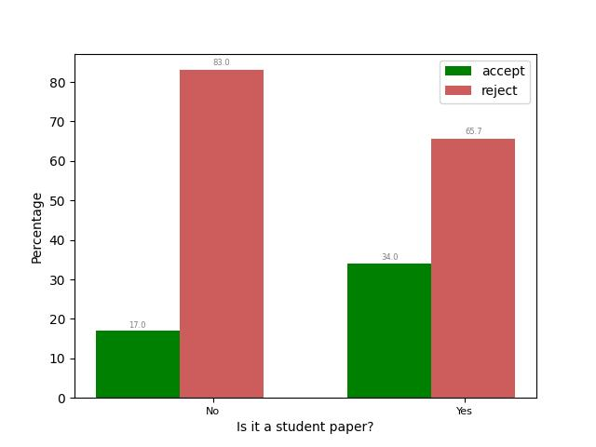
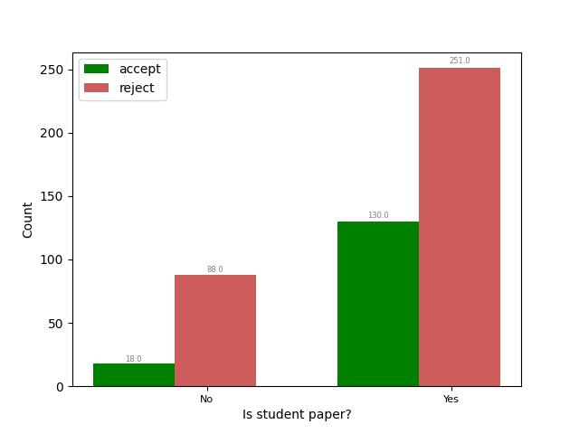
Student paper – first author is a student
Significant jump in acceptance percentage when a student is the first author – why?

Slide 108
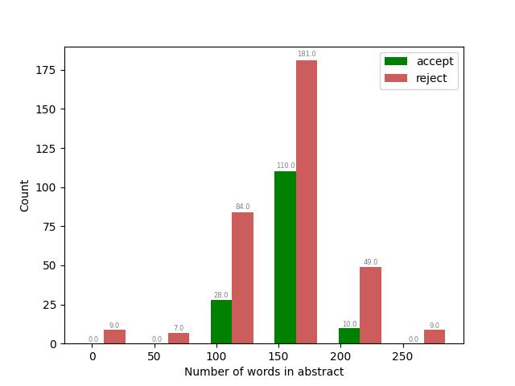
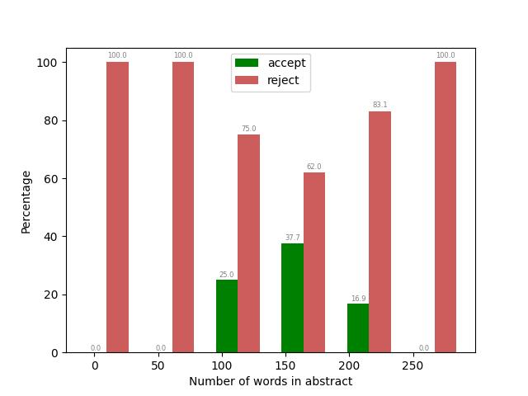
Number of words in the abstract
Too long or too short an abstract is not good

Slide 109
Other factors
Other factors tried but no significant visual difference
Number of words in the title
Number of characters in the title
...
...

Slide 110
Summary
Data attribute types: nominal, binary, ordinal, interval-scaled, ratio-scaled
Many types of data sets, e.g., numerical, text, graph, Web, image.
Gain insight into the data by:
Basic statistical data description: central tendency, dispersion, graphical displays
Data visualization: map data onto graphical primitives
Measure data similarity (not discussed)
Above steps are the beginning of data preprocessing.
Many methods have been developed but still an active area of research.

Slide 111
References
W. Cleveland, Visualizing Data, Hobart Press, 1993
T. Dasu and T. Johnson. Exploratory Data Mining and Data Cleaning. John Wiley, 2003
U. Fayyad, G. Grinstein, and A. Wierse. Information Visualization in Data Mining and Knowledge Discovery, Morgan Kaufmann, 2001
L. Kaufman and P. J. Rousseeuw. Finding Groups in Data: an Introduction to Cluster Analysis. John Wiley & Sons, 1990.
H. V. Jagadish, et al., Special Issue on Data Reduction Techniques. Bulletin of the Tech. Committee on Data Eng., 20(4), Dec. 1997
D. A. Keim. Information visualization and visual data mining, IEEE trans. on Visualization and Computer Graphics, 8(1), 2002
D. Pyle. Data Preparation for Data Mining. Morgan Kaufmann, 1999
S. Santini and R. Jain,” Similarity measures”, IEEE Trans. on Pattern Analysis and Machine Intelligence, 21(9), 1999
E. R. Tufte. The Visual Display of Quantitative Information, 2nd ed., Graphics Press, 2001
C. Yu , et al., Visual data mining of multimedia data for social and behavioral studies, Information Visualization, 8(1), 2009

